Slide 1

Understanding Binary and logic
By: Shannon Palmlund

Slide 2

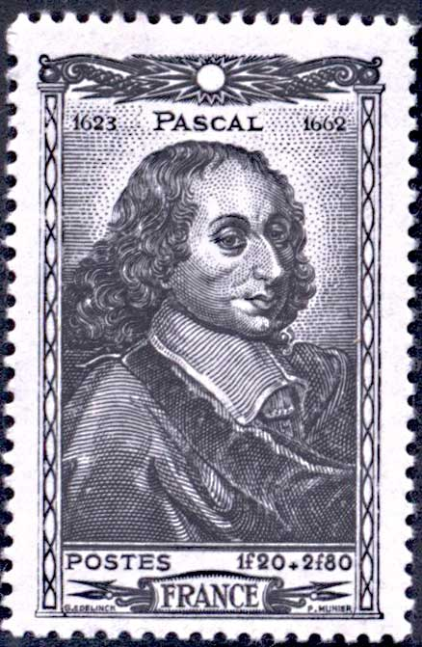
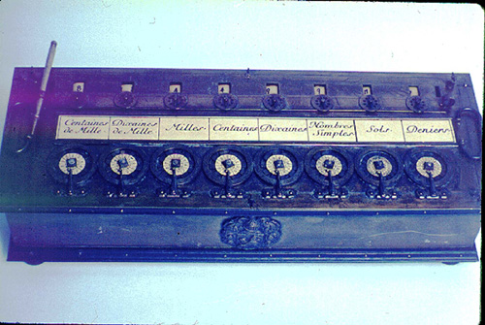
The Evolution of Computers…
2700-2300 BC – Counting Boards
(1387 AD: Termed, Abacus) [1]
1613: “Computer” – a person who carries out calculations and computations. [2]
↑ Early Abacus, 2nd Century BC [1]
1642: Frenchman, Blaise Pascal, constructed the first calculating machine. [3]
← Blaise Pascal [3]
← Pascal’s Pascaline [2]
Notes:
Why did computers develop? Because of the human need to quantify
2 – Click…(counting boards to the abacus)
Where did the term computers come from?
3 – Click – “human computer”
Because of human error, people were constantly working to better the process
4 – Click (Finally, Blaise Pascal) – the Pascaline was built to help his father who was a tax collector.
It could only add and was quite expensive and not very accurate because gears were not very precise
Fun Fact: The odometer portion of the spedometer (up until it went digital) worked exactly the same as the pascaline “increment the next wheel after a full revolution of the first wheel)

Slide 3
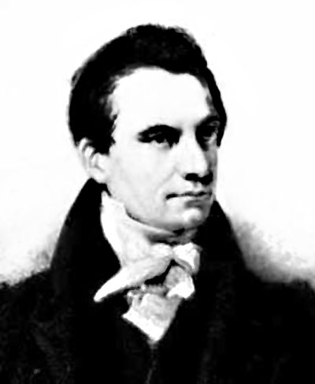
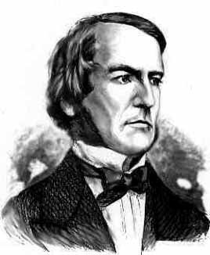
The Evolution of Computers…
1823: Englishman, Charles Babbage, called “Father of Computers” [2]
Created structure of computers calculating abilities
Created Programs for analytical calculating machine
Store - Memory | Mill - CPU
Charles Babbage [3]
1835: Englishman, George Boole, develops symbolic logic used in programs today. [3]
Boolean Logic
George Boole [3]
Notes:
Click 1 – Father of Computers, Charles Babbage – working on a steam driven calculating machine
He took an earlier idea, Jacquard’s weaving loom which used punched cards to let colored thread through as the basis for his calculating machine realizing that the punched cards could be used as a storage device.
He called the two main parts of his Analytic Machine the store and the mill
Fun Facts: His Girlfriend, Ada Byron was so fascinated by his ideas she created the first programs
Fun Facts: Babbage went on to develop the modern postal system
Click 2 – George Boole – will talk more about Boolean Logic later

Slide 4
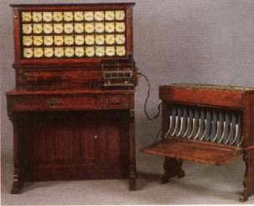
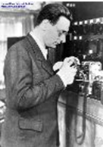
The Evolution of Computers…
1890: Herman Hollerith wins prize [2]
Gear-driven mechanism
Used Pascal’s device and dials as indicators
Started the International Business Machine Company
Hollerith Desk [2]
1939: Bulgarian, John Vincent Atanasoff creates first electronic-digital computer [3]
Teamed with electrician Clifford Berry
Work in base-two
Use Boolean Logic (obviously based on the findings of George Boole, 1835)
Regenerative memory (with use of capacitors). DRAM
John Vincent Atanasoff [3]
Notes:
Click 1 – US Constitution states that a census should be taken every 10 years to determine representation in the US Congress.
In 1880 that census took 7.5 years to tabulate and the population was still increasing – The census bereau offered a prize to the inventor who could make this process easier – reward to Herman Hollerith
Hollerith took the idea of the punch cards and added to it to create the Hollerith Desk
It also had a gear-driven mechansim (based on Pascal’s Pascaline) for counting and dials to display the counts
Fun Fact: Since the cards that were created could not be changed, we call it a READ ONLY technology and he worked to find a way to create a READ/WRITE technology
Click 2: John Vincent Atanasoff professor of math and physics at Iowas State university.
He used the initial IBM products but he found the machines slow and inaccurate…

Slide 5
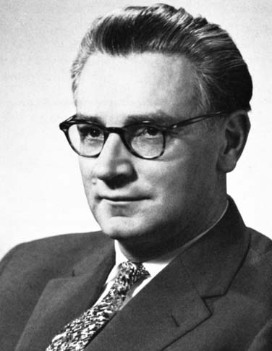
The Evolution of Computers…
1941: German Konrad Zuse creates first fully functioning, program-controlled electromechanical digital computer [3]
He knew nothing of what was being done elsewhere!
His computer is the basis for our microcomputer today [2]:
an arithmetic unit for calculations,
a memory for storing numbers,
a control system to supervise operations,
and input and output devices to connect to the external world
Konrad Zuse [3]
Notes:
Click 1 – Zuse was working with the German army to produce a computer to aid in aircraft bombing
Others continued the work of the previous by adding bits and pieces along the way – most of the evolution can be directly linked with war tactics to gain the upper hand

Slide 6
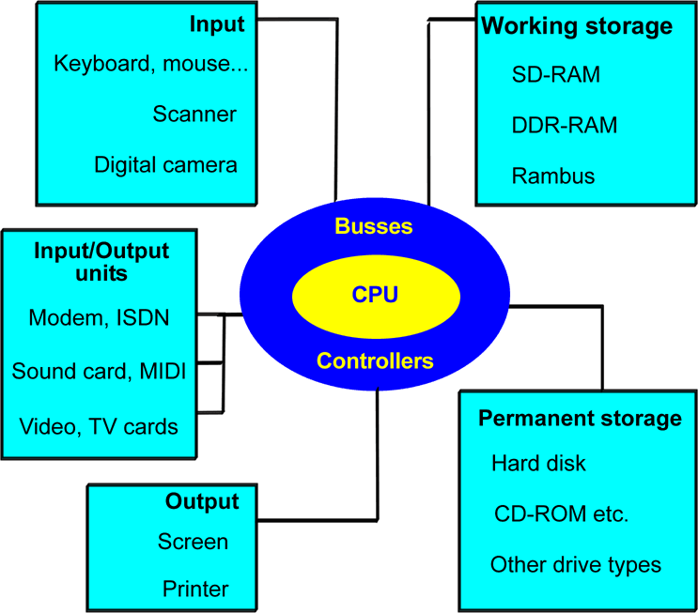
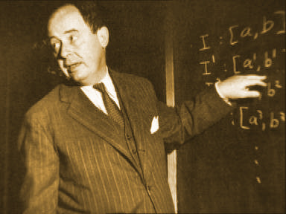
The Evolution of Computers…
1940’s: John Von Neumann created a model of the basic computer’s hardware that is still used today. [3]
Constructed first computer with working storage
5 Primary Groups
* CPU * Input * Output
* Working Storage
* Permanent Storage
John Von Neumann [3]
The Von Neumann Model [3]
Notes:
Click 1 – In the 1940’s John Von Neumann …
Click 2 and 3 – Explanation – His model was based on the human body and it’s organs
This led to the…..
microcomputer, because it was the smallest of all computers.
The PC “Personal Computer” originated in 1981.
So…Several of those involved in the evolution of the computer knew that working in letters, numbers and symbols would be difficult and time consuming for a computer – which leads us to the understanding of binary

Slide 7
Binary to Denary Conversions
1939 – Antanasoff uses Binary System [3]
Where does the word, BIT come from?
Binary digITs: It is either OFF (0; False) or ON (1; True) (just like a light switch producing electricity)
Everything in “computer” is converted to the Binary state.
How to convert our Number Line to binary…
Each BIT (Binary digIT) increases by powers of 2
0=0 (False; Off – Worth Nothing)
1=1 (True; On – Worth 1)
2=10
3=11
4=100
5=101
Binary # for 2
Number Line → | 4 | 3 | 2 | 1
Above Worth →
Binary for “2”→
8
4
2
1
→ 2 + 0 = 2
1
0
→ “0” means Off!
Notes:
Click 1 – Remember Antanasoff –based computers on binary working with the electrical on or off state thus creating the binary logic of computes (click 2)
Click 3 – understanding binary

Slide 8
Binary to Denary Cont.
Binary # for 3
Number Line → | 4 | 3 | 2 | 1
Above Worth →
Binary for “3”→
8
4
2
1
→ 2 + 1 = 3
0
1
1
→ We want both “on”
Binary # for 4
Number Line → | 4 | 3 | 2 | 1
Above Worth → | 8 | 4 | 2 | 1
Binary for “4”→
→ 4 + 0 + 0 = 4
1
0
0
→ Remember R to L!
Binary # for 5
Number Line → | 4 | 3 | 2 | 1
Above Worth → | 8 | 4 | 2 | 1
Binary for “5”→
→ 4 + 1 = 5
1
0
1
→ Remember R to L!
Notes:
Clicks through

Slide 9

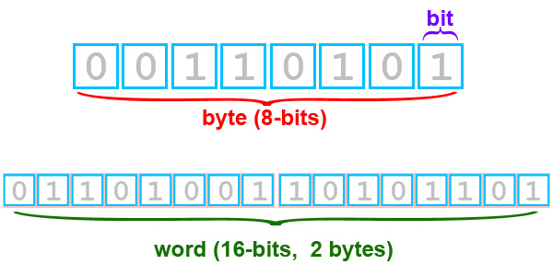
Bits and Bytes
Bits (Binary digITS) are rarely seen alone in computers today – they are bundled in to bytes [4]
There are 8 bits to a byte!
Why 8?
Why the word, Byte? “Don’t BYTE (input) off more than you can chew (process/output).
There are 16 bits in a word…
← Bits, Bytes, Word [4]
Notes:
For an input of 2 variables, there are 16 possible boolean algebraic functions the computer recognizes

Slide 10
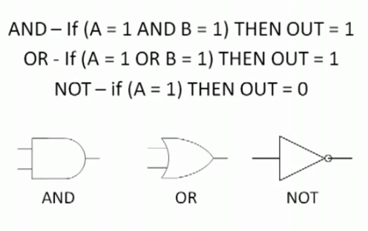
Boolean Logic with Binary
So how do we get the bits to represent the ON or OFF state?
A circuit will need to be created using Boolean Logic and Gates [4]
Note that A and B are representing 0’s and/or 1’s
← Boolean Logic Statements [4]
There are also NOR, NAND, XOR, and XAND Gates.
Notes:
Click 1 – Back to Boolean Logic
We use boolean logic in every day life probably without even realizing it
We also use it when we are searching for things on the internet
Click 2 – The Output or answer to the algebraic equation using Boolean Logic leads to an answer of either on or off, 1 or 0, T or F
Boolean logic was used for its logic gates as the next diagram shows…

Slide 11
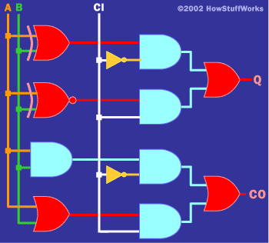
Boolean Logic with Binary Cont.
Below is one example of a binary circuit.
XNOR GATE
AND GATE
OR GATE
XNOR GATE
The Carry In and Carry Out allow you to
move from Bit to Bit…
NOT GATE
← Boolean Logic Statements [4]
Notes:
These logic statements represent voltages or currents that are turned on or off throughout the machine allowing it to send output according to our needs – in English!
So why use circuits?
this is the least expensive way to mass produce a logical gate and a logical gate use the fewest number of transistors in order to reduce their size, power consumption and cost, and increase reliability

Slide 12
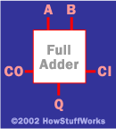
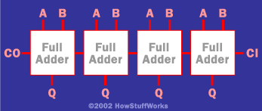
Bits to Boxed
Once one adder is created, it is “black-boxed” [4]
Boolean Logic Statements [4] →
Below is an example of 4 bits on a circuit board [4]
Just think – a 64 Bit Operating System is now available (and these are just the adders!)
Boolean Logic Statements [4]
Notes:
A black-box is an object which receives and sends messages. A black box actually contains code (sequences of computer instructions) and data (information which the instructions operates on).
Black Boxed so they were not messed with which would cause your software to no longer work correctly

Slide 13

RAM
1940’s: John Von Neumann – created first computer with working storage…
RAM – Random Access Memory is created by a process called feedback. [4]
The below is an example of a simple inverter…
← Boolean Logic Statements [4]

Slide 14
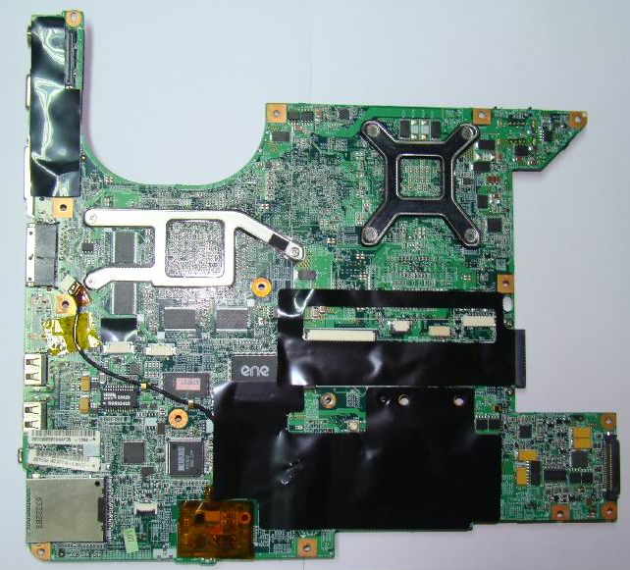
The Chip
In the past, relays were used, but today, sub-microscopic transistors etched onto silicon chips are used. [4]
HP Pavilion DV6 Motherboard →

Slide 15
End Notes
[1] History of computers. (2006, December 29). Retrieved from http://www.hitmill.com/computers/history/abacus.html
[2] Kopplin, J. (2002). Computer history. Retrieved from http://www.computersciencelab.com/ComputerHistory/ History.htm
[3] Karbo, M. (2005). The Security portal for information system security professionals (Microsoft Word Upload), Retrieved from http://www.snpx.com/cgi- bin/infosyssec.cgi?target=chapter01.htm
[4] How stuff works. (1998-2010). Retrieved from http://computer.howstuffworks.com/boolean2.htm

